Slide 1



Riby Sales Analysis (PP
View in Power BI
Last data refresh:
2/13/2023 11:51:15 AM UTC
Downloaded at:
2/13/2023 11:56:42 AM UTC

Slide 2
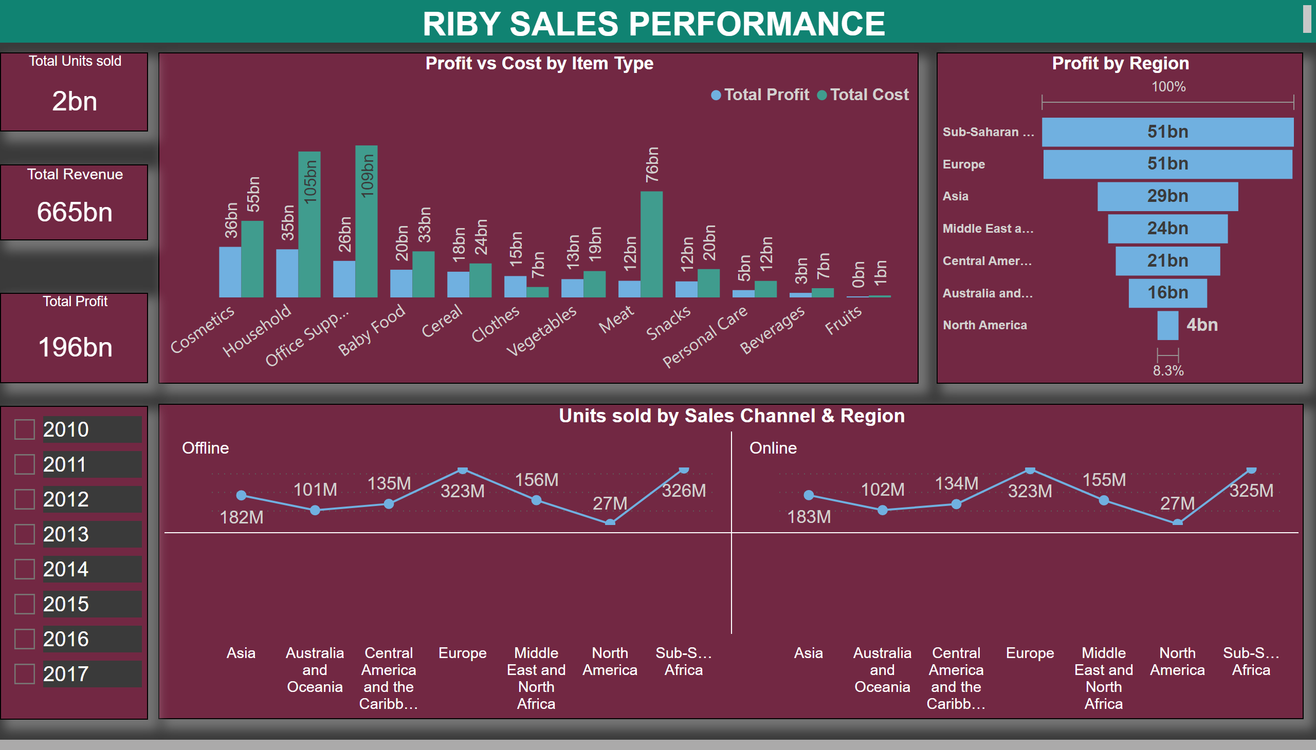
Page 1
Notes:
Profit by Region
No alt text provided
Profit vs Cost by Item Type
No alt text provided
textbox
No alt text provided
Total Units sold
No alt text provided
Total Revenue
No alt text provided
Total Profit
No alt text provided
Units sold by Sales Channel & Region
No alt text provided
slicer
No alt text provided

Slide 3
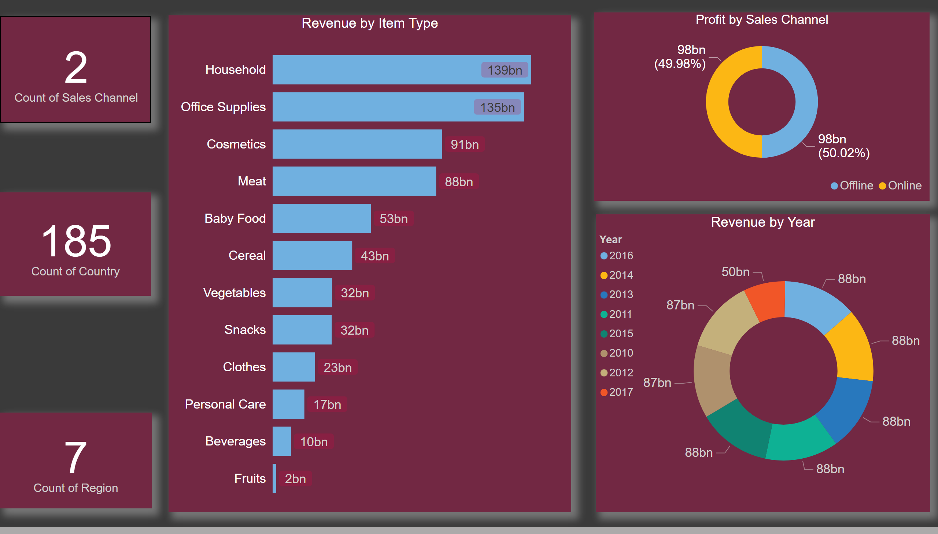
Page 2
Notes:
card
No alt text provided
card
No alt text provided
card
No alt text provided
Revenue by Item Type
No alt text provided
Profit by Sales Channel
No alt text provided
Revenue by Year
No alt text provided

